Slide 1
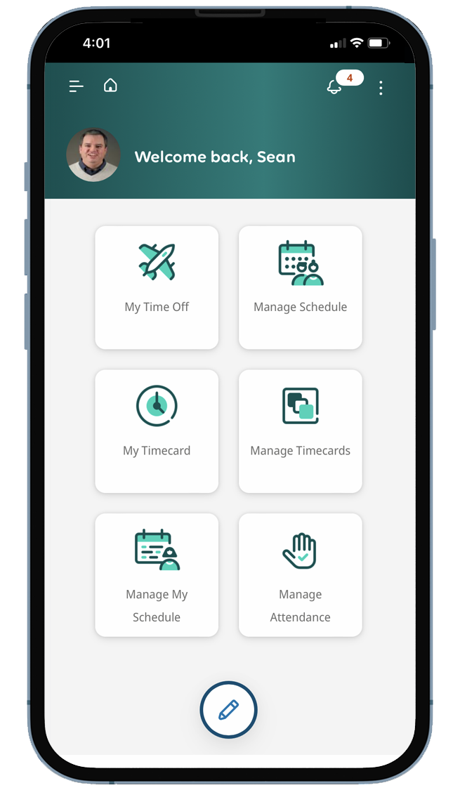


Easy to use
  Jump right in with a familiar,
  consumer-grade interface.
Flexible
  Transition easily from laptop to tablet to phone to work from anywhere.
Empowering
  Gain more input into and
  control over scheduling.
Insert screen
image and
send to back
To access UKG from your computer: https://wedgewoodpharma.ukg.net

