Slide 2





Current Challenges in Healthcare
More patients
Fewer PCPs
Increasing costs
More visits and longer wait times
Misuse of ER
Notes:
*More visits and longer wait times: 19 day average
*80% go due to of lack of access; 85% couldn’t wait to see their PCP

Slide 3


Teladoc Can Help!
Teladoc provides access to licensed physicians 24/7, 365 days a year. You can get medical advice and treatment by phone, online video or with the Teladoc mobile app.
Use Teladoc for medical advice and care:
For non-emergent medical issues, questions or concerns
When your primary doctor is not open
When you are at home, traveling or do not want to take time off work to see a doctor
When you need prescription refills*
*Please note, there is no guarantee you will be prescribed medication.

Slide 4
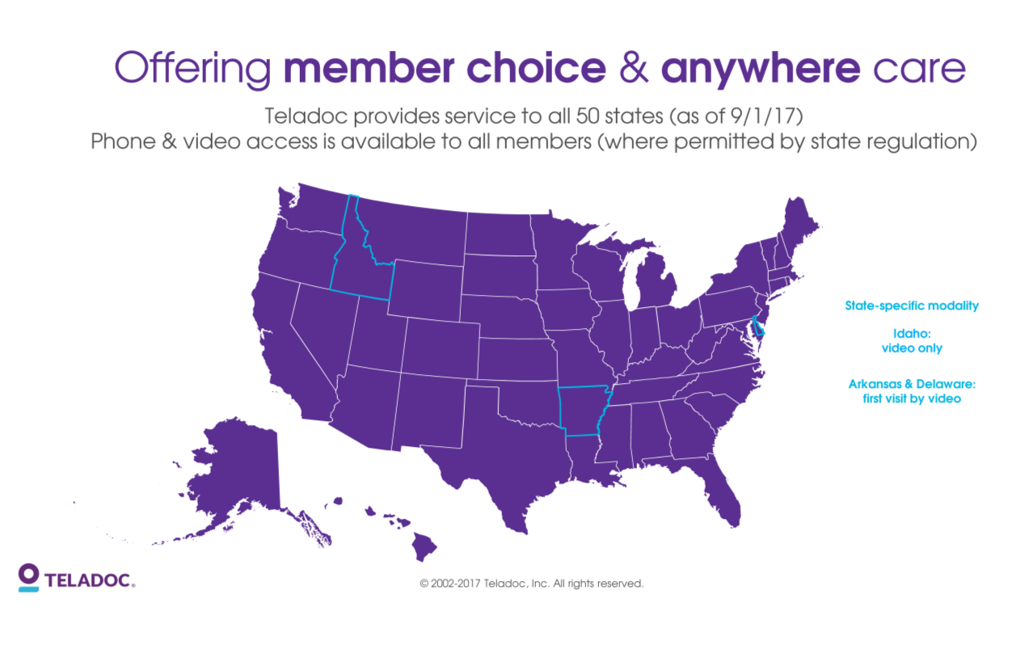
Teladoc Coverage Map

Slide 5





Benefits of Teladoc
Saves time and
money
Faster recovery
from illness
Convenient access to prescriptions
Personal choice of
consultation method
Great health means
peace of mind
92% of people who used Teladoc avoided a visit to the doctor’s office, urgent care or the ER
Notes:
Save time: Avoid waiting for an appointment or sitting in a doctor’s office or ER
Save money: Cost reductions compared to doctor’s office, urgent care and ER visits
Peace of mind: Quality care any time
Prescription program: Prescriptions and refills available, if appropriate
Health portal: Interactive online tools for your health

Slide 6

Highly Qualified Physicians
When you use Teladoc, your medical questions will be answered by a highly qualified doctor. Teladoc doctors are :
Experienced
With an average of over 10–15 years in practice
Qualified
Licensed, credentialed and based in the U.S.
Quality of Care
95% of satisfaction rate
Compassionate
Professional and knowledgeable
Quality Assurance
Consultations are reviewed to assure quality care standards
The average consultation with Teladoc lasts 14 minutes.
Notes:
*Quality of care:

Slide 7
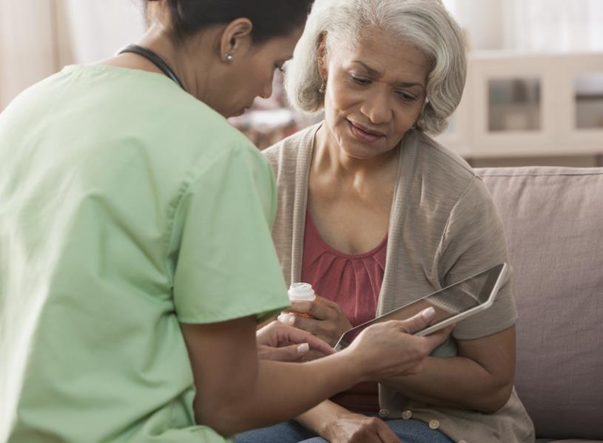
Most Commonly Treated Conditions
Cold
Flu
Sinus infections
Upper respiratory infections
Allergies
Headaches
Urinary Tract Infections
Bronchitis
Stomach ache/diarrhea
Eye infections
Ear infections
Rashes/skin irritations
Yeast infections

Slide 8
“First time I ever used the service and it was so easy. I knew what I had and was able to call while I was getting ready for work, and on my way in picked up my prescription. In two days I was feeling much better. I will use the service again.”
- Actual Teladoc Member Experience

Slide 9
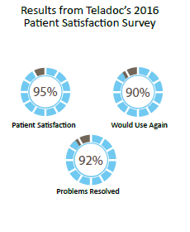
Patient Satisfaction Survey

Slide 10
“It’s the greatest service that I have honestly had. I’m a nurse and I knew what was wrong with me, but I am new to California and I don’t know anybody and I’m not established out here. I came down with an upper respiratory infection, and I had to miss work. I tried to go to a walk-in clinic, but it did not work out so I came home and slept. Got up the next day still running a fever, made a phone call to Teladoc and in 10 minutes they called me back and wrote me a script. I really appreciate what Teladoc does.”
- Actual Teladoc Member Experience

Slide 11

Getting Started is Simple
Set up your account
By phone: call 1.800.362.2667
Online: at www.Teladoc.com
Complete your Medical History
Disclosure (MHD)
By phone: Teladoc can help you complete your MHD over the phone
Online: Log on to your account at www.Teladoc.com
and click My Medical History

Slide 12
Setting up Your Account
Set up your account
Online: at https://www.Teladoc.com/
Click “REGISTER”

Slide 13
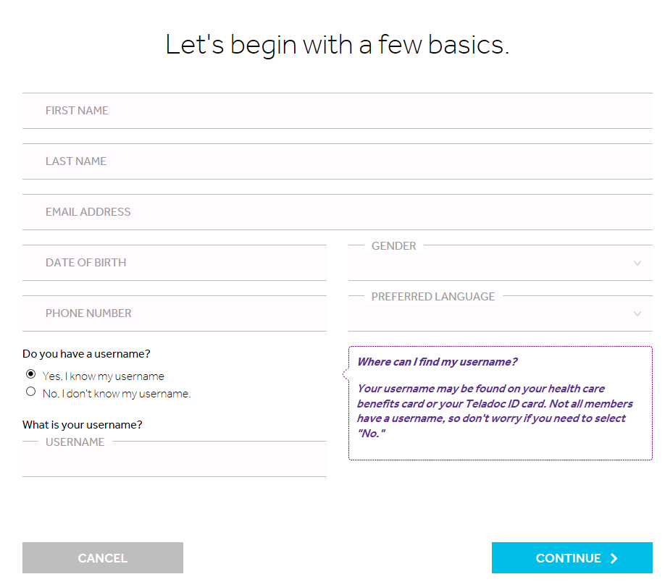
Setting up Your Account
Complete the required fields:
First Name
Last Name
Email Address
Date of Birth
Phone Number

Slide 14
Setting up Your Account
Enter personal information:
Additional personal information will be entered on this screen after your eligibility has been verified

Slide 15
Setting up Your Account
Creating your username and password
Please maintain a record of this information for future access to your account

Slide 16
You’re all Set!

Slide 17
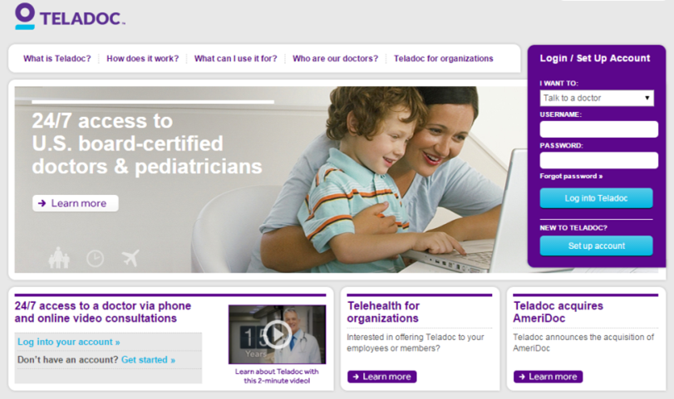
Using www.Teladoc.com
Use the website to:
Complete or update your Medical History Disclosure (MHD)
Request a consultation
Access the Message Center for post-consult care directions and ask follow-up questions
Print ID cards
Get answers to frequently asked questions (FAQs)

Slide 18
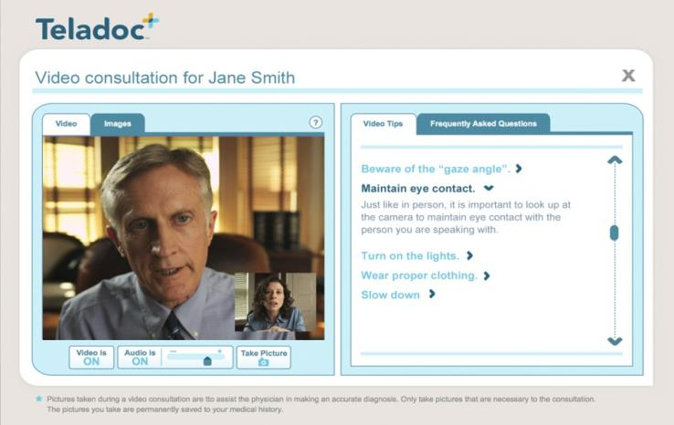
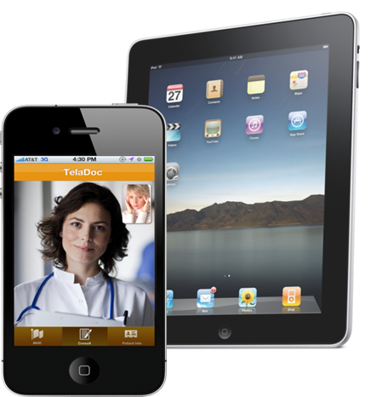
Additional Features
Request video consultations*
Download the mobile app
*Note: not available in AR or TX

Slide 19

Requesting a Consultation
From any page within the member’s account, click the purple
Request a Visit button in the upper right hand corner
Notes:
*Note: you can choose to have a doctor call you back (usually within an hour) or to schedule an appointment for your consultation. Appointments are available from 7:00am to 9:00pm

Slide 20

Provide Consultation Details
Select the member the visit is for
For minors, a section will appear requiring selection of the adult authorized to be on the phone during the consultation
An adult is required to be on the phone during the consult for any minor under 18
Select the state in which the member is located. This will expand for product selection (ex. General Medical, Derm)
Once selected the option for phone or video will appear. Then the option for “as soon as possible” or “scheduled”
Image Upload option available
Select the phone number the physician will use to contact the member
Enter any necessary notes for the physician
Determine whether you want a copy of your consult to go to your PCP
Select your Pharmacy
Notes:
*Note: you can choose to have a doctor call you back (usually within an hour) or to schedule an appointment for your consultation. Appointments are available from 7:00am to 9:00pm

Slide 21
Confirm Billing Information
If you have a visit fee, then you will need to select how you plan on paying for the visit.
Billing options will display including credit card and PayPal.
Notes:
*Note: you can choose to have a doctor call you back (usually within an hour) or to schedule an appointment for your consultation. Appointments are available from 7:00am to 9:00pm

Slide 22

Review and Submit
Review your information to make sure it is accurate, and then click submit
You will receive a confirmation page with a confirmation number. Please keep this number for your records in the event you need to contact Member Services regarding your visit.
A physician will then contact you at the number you provided during your visit request
Notes:
*Note: you can choose to have a doctor call you back (usually within an hour) or to schedule an appointment for your consultation. Appointments are available from 7:00am to 9:00pm

Slide 23


Thank you!

